Slide 1
The Data Cards Playbook
A toolkit for purposeful and people-centric dataset documentation for transparency in AI systems.
https://pair-code.github.io/datacardsplaybook/ #datacardsplaybook

Slide 2


Introduction
01 Ask 02 Inspect
03 Answer
04 Audit

Slide 3
Assemble your Template
THE DATA CARDS PLAYBOOK
Structure your lenses and scopes into a Data Card template that works for producers and agents alike.

Slide 4
Organize lenses and scopes into a Data Card template by converting lenses to titles and structuring scopes as questions that Producers of datasets will fill out.
A Data Card template that contains the most useful information for you agents, which can be inspected, tested, and implemented.
Moderate

Slide 5
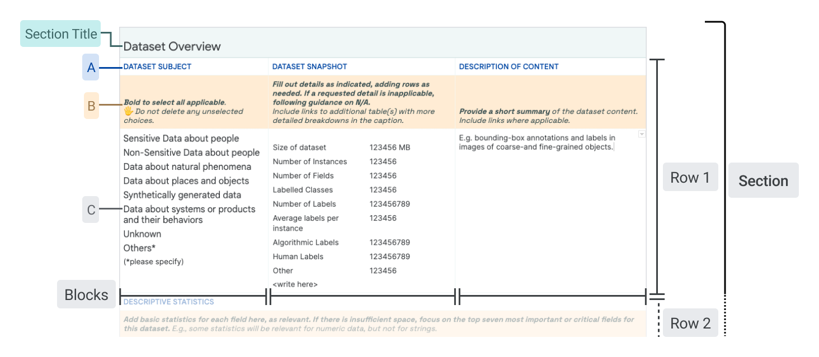
Consider this structure
Lens →
Scopes →
Expected behaviors → and context from lenses
Structure and choice → derived from consolidating lenses and scopes
↑ Agent Information Journey(s)
Telescopic Content ↑
Periscopic Content ↑
Microscopic Content ↑

Slide 6
Meaningfully arrange your AIJs into a template for Data Card(s).
Lenses can sections or “blocks” in a data card. Scopes describe the questions in each block. Organize these so readers are able to navigate information reasonable as they read the Data Card from top to bottom (across blocks), hierarchically (from blocks to questions), and horizontally (across questions).

Slide 7

Best practices for assembling Data Card templates
You may need to re-organize your lenses & scopes for a more refined completion and reading experience. Here are some helpful strategies:
Combine scopes that pose similar or related questions, even if they were born from different lenses
Prefix straggler microscopes or periscopes with conditions that are reflected in their telescopes
Convert similar telescopes into answer choices that producers can select from; including “Others (please specify)
Reflect additional context from lenses and related scopes in the suggested structure of answers
Use a nested organization schema so it’s easy to fill and navigate completed Data Cards. Consider these two experiences when creating catch-all rows
Add specificity to binary choices by being explicit about conditions, rather than offering Yes/No or True/False as potential choices

Slide 8
EXAMPLE
Publishers of the dataset
FUNCTIONAL CRITERIA
TELESCOPIC
PERISCOPIC
MICROSCOPIC
Include this when:
✍️ Data Card will be public
What’s the name of the institution or organization who published it?
Which team, group, or group of individuals are responsible for publishing the dataset?
Who’s (individual) primarily responsible for publishing the dataset?
What kind of institution or organization is the publishing party?
What is the mission statement of the publishing party?
Include this when:
✍️ Publishers are outside USA
Where are publishers located?
Include this when: ✍️ Publishers are not the creators of the dataset.
If the publishers are different from creators of the dataset, who are the creators?
How are creators involved with the dataset if different from publishers?
Can publishers be contacted?
How and can publishers be contacted?
For what purpose should publishers be contacted?
Notes:
Recommended duration: 15 minutes per lens
Pro-tip: Convert the Lens into a title, and organize the scopes into swimlanes
Use the following prompts to discuss and evaluate each section:
Does this section support the attributes and characteristics described in the Persona Worksheets? Which personas and how?
Is this category too dense or sparse? Is this intentional?
Is there a meaningful hierarchy expressed in the lenses & scopes?
How does this section relate to others? Are there any other sections or subsections that are relevant?

Slide 9
15
min
Facilitator’s note
Duplicate for each lens.
Delete this note once you’re done with it.
✍️ Convert lens into a section title
FUNCTIONAL CRITERIA
TELESCOPIC
PERISCOPIC
MICROSCOPIC
Include this when:
✍️ Condition
✍️ Telescopic Question
✍️ Periscopic Question
✍️ Microscopic Question
Notes:
Recommended duration: 15 minutes per lens
Pro-tip: Convert the Lens into a title, and organize the scopes into swimlanes
Use the following prompts to discuss and evaluate each section:
Does this section support the attributes and characteristics described in the Persona Worksheets? Which personas and how?
Is this category too dense or sparse? Is this intentional?
Is there a meaningful hierarchy expressed in the lenses & scopes?
How does this section relate to others? Are there any other sections or subsections that are relevant?

Slide 10
Final checks
YOU SHOULD NOW HAVE
_
Agreed on the top 2-5 agents of the Data Card
Prioritized the Agent Information Journeys addressed by your Data Card (lenses)
Produced specific questions and prompts to answer in your Data Card (scopes)
Created a Data Card Template
✔
✔
✔
✔

Slide 11

#datacardsplaybook
The Data Cards Playbook ↗ is an adaptable toolkit of participatory activities, conceptual frameworks, and guidance that support Responsible AI practices for transparency in dataset documentation.
If you’ve adapted, implemented, or have feedback for this guidance, we’d love to hear from you at https://github.com/pair-code/datacardsplaybook ↗.
Find the complete playbook at https://pair-code.github.io/datacardsplaybook ↗

Slide 12

The Data Cards Playbook ↗ by the People + AI Research Initiative ↗ at Google Research ↗ is licensed under a Creative Commons Attribution-ShareAlike 4.0 International License. You are free to share and adapt this work under the appropriate license terms ↗.

